Slide 1
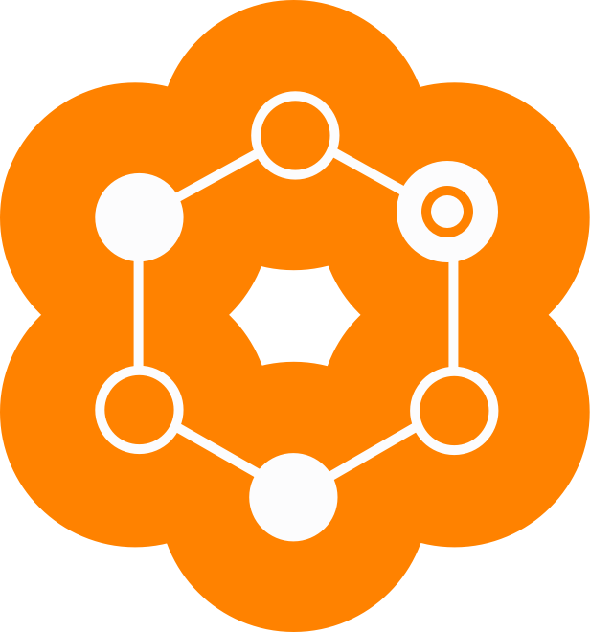
Marketing HALO to Existing Clients

Slide 2
Why HALO should be used with existing Clients
Deepens the client relationship
Extends reach into the family
Improves strategy recommendations
Potential to sell more products
Prevents unnecessary spend down of AUM
Creates a better educated client
Notes:
DEMO

Slide 3
What does HALO do?
Deepens Client Relationship
Prevent AUM Spend Down
Educate Clients
Notes:
DEMO

Slide 4
How to Use Halo
Have clients take HALO during your annual meeting with them
Two ways to share HALO with your clients
Send the client an email invitation to take HALO
Have the client take HALO on your computer when you are in your face-to-face meeting
Set a reminder in your calendar to have your client take HALO on an annual basis to capture the most up-to-date information on their health risks
Notes:
DEMO

