Slide 1
Marketing HALO to Prospective Clients

Slide 2
It’s a hot topic among investors
HALO is the only planning solution for health and care costs that is personalized and science based
Grows your practice

Slide 3
What HALO Does for Lead Generation
Educates people on a topic of interest
Distinguishes your practice from others
Reaches family members as referrals
Notes:
DEMO

Slide 4
How to use HALO with Prospective Clients
Conduct live seminars, lunch-n-learns
For reaching younger investors, “What if your parents’ retirement plan was you, and what you can do about it”
For mature investors, “Put a HALO around your financial plan”
Post ads on social media with a call to action invitation to your HALO
Drive traffic to your website with HALO with key word search and search engine optimization
Did you know that health care costs and health care planning are some of the most searched terms on the internet?
Ask for referrals from existing clients who have taken HALO
Most people who take HALO want to share it with their family and friends
Notes:
DEMO

Slide 5
The Ideal Client
Pre-retiree or retiree who has:
gone through the process of caring for an aging parent
assets between $500K-$10M
adult children who have started their own families with disposable income of about $10,000
Notes:
DEMO

Slide 6
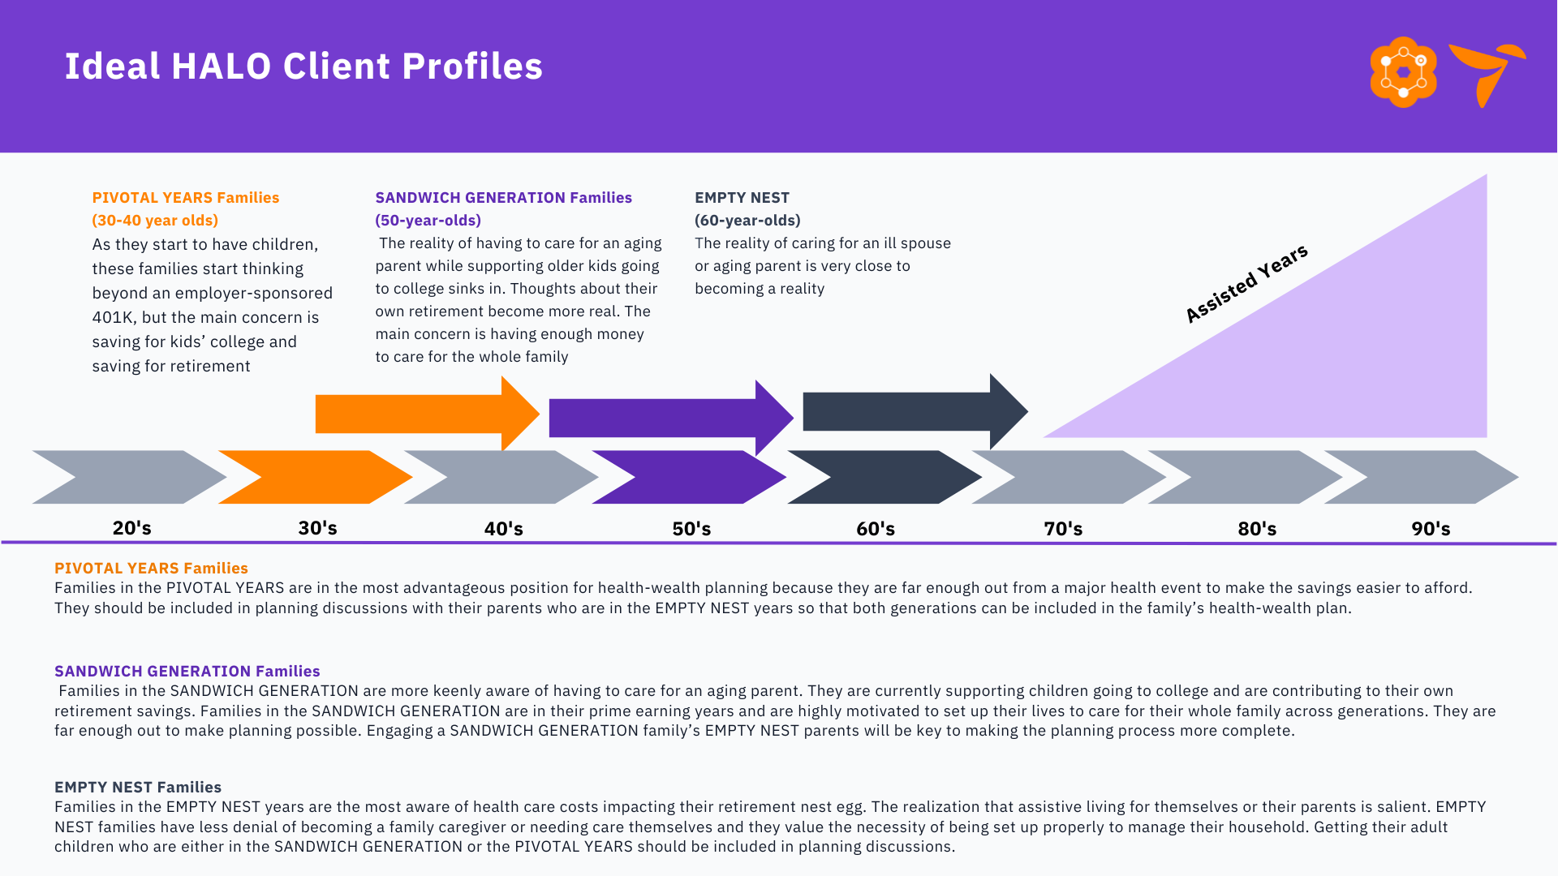
Client Segments
Notes:
DEMO

